Slide 1
Big Game Census Analytics

Slide 2
INTRODUCTION
Purpose: Analyzing birthplace and population data
of NFL players.
Source of Data: Super Bowl player rosters and U.S.
Census Bureau data.
Methodology: Visualization using Power BI

Slide 3
DETAILS OF THE DATASET
Dataset: "Big Game Census Data"
Columns:
Player Name
Player Jersey Number
Player Position
Player Age
Player Weight (lbs.)
Years Played
Player Birthplace (City, State)
Player College
Player Team
Conference
Population Data (2016)

Slide 4
DETAILS OF THE DATASET
Dataset: "All Places Census 2016 Population Estimates"
Columns:
Geographic ID (GEOID)
GEOID 2
Geography (City, State)
Census Data (2010)
Estimates Base (2010)
Population Estimates (2010-2016)

Slide 5
DETAILS OF THE DATASET
Dataset: "All States Census 2017 Population Estimates"
Columns:
GEOID
GEOID2
Geography Name (State)
Census Data (2010)
Estimates Base (2010)
Population Estimates (2010-2017)

Slide 6
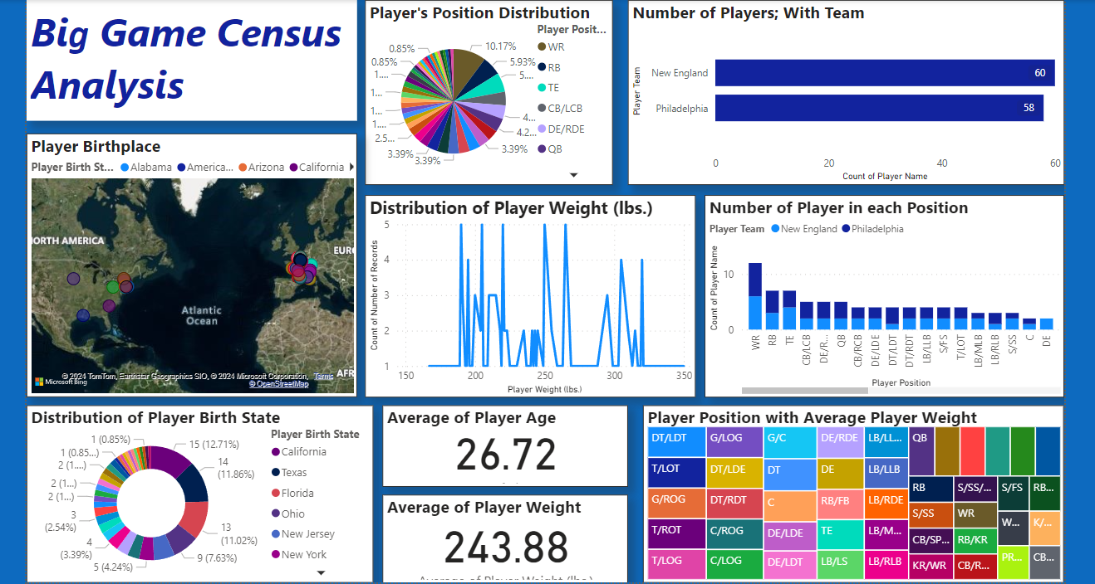
DESIGNED DASHBOARD

Slide 7
THANK YOU
PPt By:- Nikki Sharma

